Slide 1
Lesson 1: Introduction to NAvigation
Seshan brothers

Slide 2
What is navigation in FIRST LEGO League?
Navigation is getting your robot from base to where it needs to be
Navigation needs to be both reliable and repeatable
To accomplish this, you need to learn several strategies

Slide 3
Navigating reliably in FIRST LEGO League
Good navigation will use some or all of these techniques
Aligning in Base
Wall following
Aligning on lines
Aligning on walls
Aligning on mission models
Line following

Slide 4
DISCUSSION
Let’s say we want to go from base to the mission marked with the pink circle.
What can you do to get there reliably?

Slide 5
Selecting a route
There may be more than one path to get to the destination
What would it take to make the red or yellow path reliable?

Slide 6
Possible Solution (Yellow)
Look for places that the robot can accurately position or orient itself
You may need to add extra moves to make it possible to position the robot
Line Follow
Align on Line
Move Until Line
Align on the Wall
Wall Follow

Slide 7
Possible Solution (RED)
Different paths may have more opportunities for alignment or introduce obstacles (e.g. a ramp) that make your position less predictable
Align on the Wall
Align on the model
Line Follow
Move Until Line
Align on Line

Slide 8
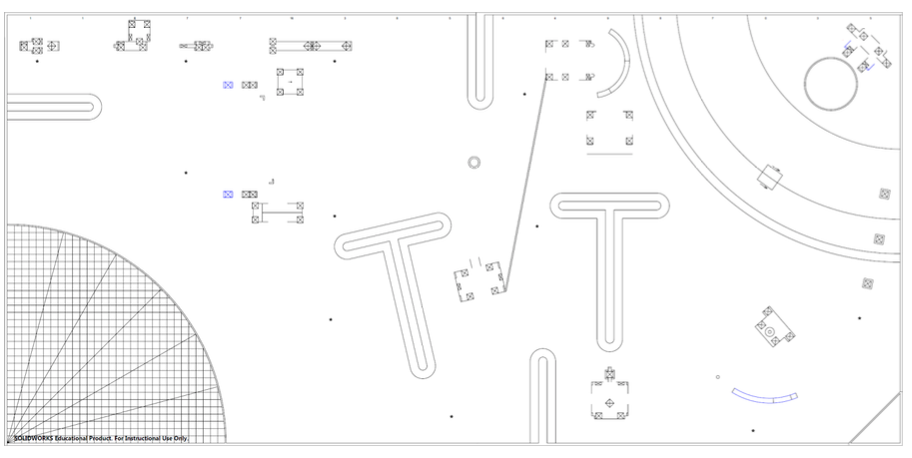
What’s NExt
Let’s learn some building and programming techniques to achieve each of these strategies
As you go through the lessons think about how your team can apply the technique to this year’s Challenge.

Slide 9

Credits
This tutorial was created by Sanjay Seshan and Arvind Seshan
More lessons at www.ev3lessons.com and www.flltutorials.com
This work is licensed under a Creative Commons Attribution-NonCommercial-ShareAlike 4.0 International License.

